Slide 1


BrisPUG

Slide 2




Sponsored By:

Slide 3

PowerShell
News

Slide 4

Windows Compatibility Module for PowerShell Core 6.1 is now Generally Available
DSC now available on AWS Systems Manager (free!)
DSC Resource Kit November Update
ICYMI – PowerShell for Azure Cloud Shell is now Generally Available

Slide 5
Module of the
Month

Slide 6
PowerShell-YAML
YAML – YAML Ain't Markup Language
Human readable format similar to XML/JSON
Quickly gaining popularity
Good for configuration information
ConvertFrom-Yaml
ConvertTo-Yaml

Slide 7
Scripting
Games
Notes:
Challenge:
The challenge is to produce a yearly Realtime graph (using (Universal Dashboard) of the top 10 stocks of stock market prices using a REST API.
Bonus Points:
Identify the trends and forecast the growth or decline based on dataset.
Identify the news regarding that stock into the graph
Sources:
https://iextrading.com/developer/docs/#stocks
https://www.morningstar.com.au/Home
Winner will win a full free PowerShell Universal Dashboard Licence!

Slide 8
Using Universal Dashboard create a real time graph of the top 10 stocks over a 12 month period using the IEX trading REST API.
Submissions to the #scripting-games slack channel.
Winner randomly selected at the next meeting

Slide 9
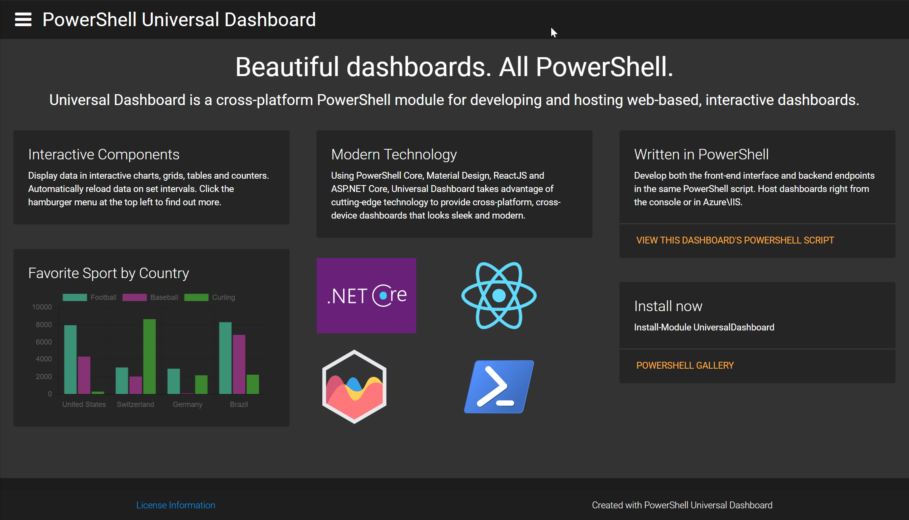

Documentation: https://docs.universaldashboard.io
Forums: https://forums.universaldashboard.io/
GitHub: https://github.com/ironmansoftware/universal-dashboard
Purchasing: https://marketplace.universaldashboard.io/Pricing

Slide 10
Using REST
with PowerShell

Slide 11


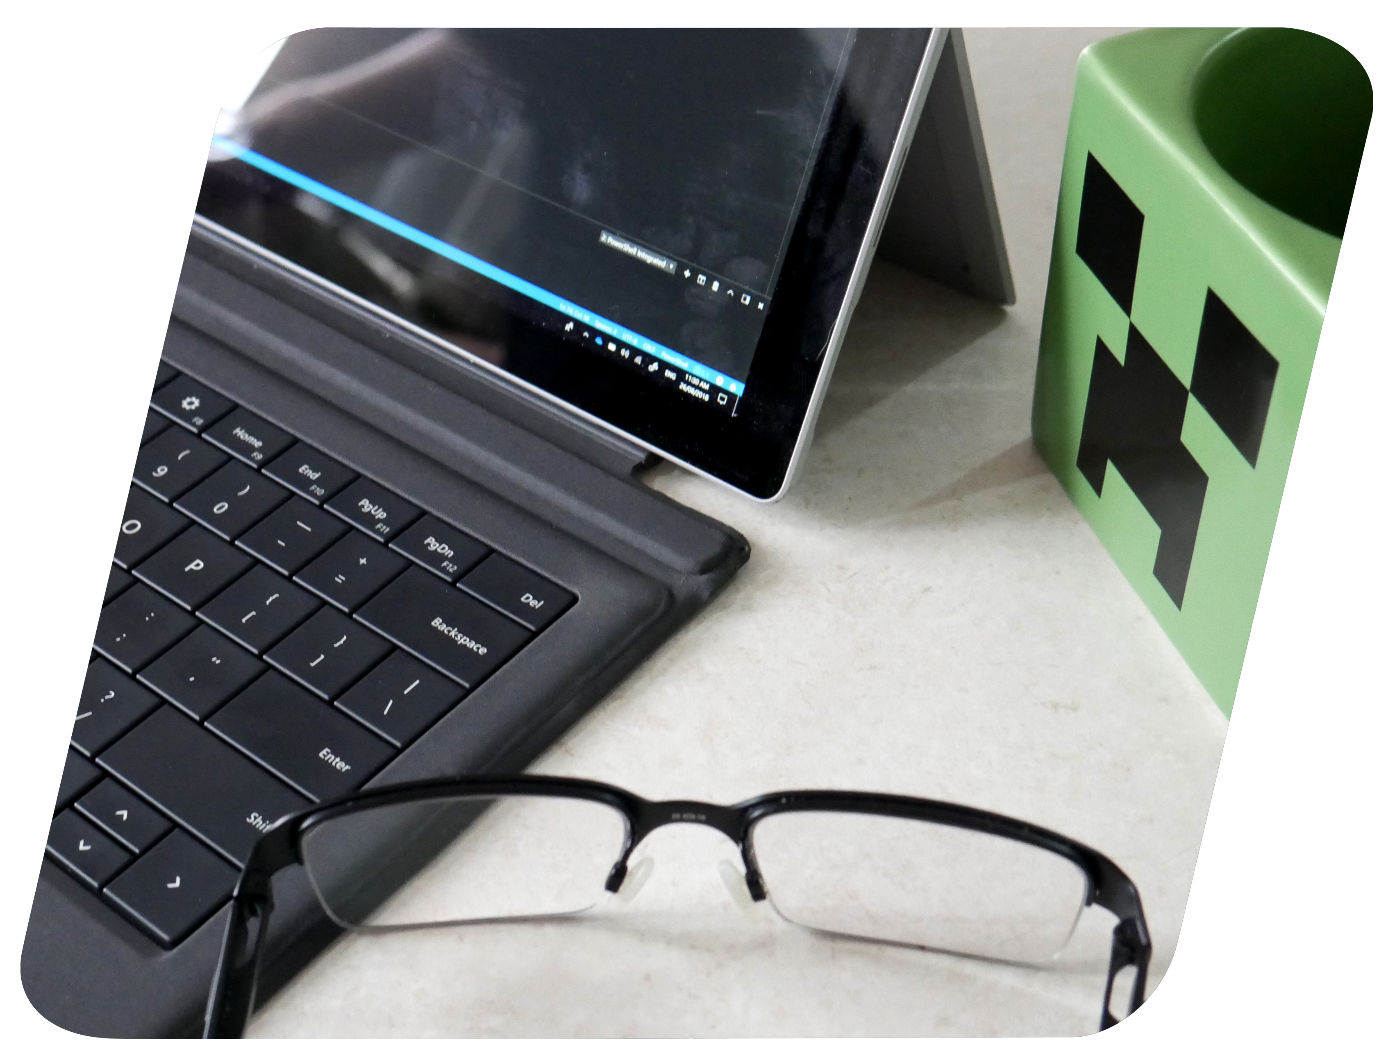
Agenda
• What is REST?
• What is JSON?
• HTTP Breakdown
• Using REST
• Demos!

Slide 12
What is REST?
• Representational State Transfer
• A Web Service Architecture
Notes:
What is REST? Representational State Transfer is a open source architecture that is used by API’s to interact with. REST was developed to be in parelle with HTTP 1.1 from HTTP 1.0. The constraints are:
Client – Server Architecture. Separation of the two user interfaces addressing security concerns.
Statelessness. No client context is uses being stored on the server between request (Eg using JSON Web Tokens – OAUTH 2.0) For Token membership.
Cacheability. HTTP allows for the use of cached content, inexplicitablity or explicitablity define being cachable. Increasing performance.
Layability. Allowing load balancing, providing caches, enforcing security polices.
Uniform Interface. Using the use of formatting services (JSON, XML) or authentication services (OAUTH, OAUTH 2.0) simplifying the endpoint process.

Slide 13

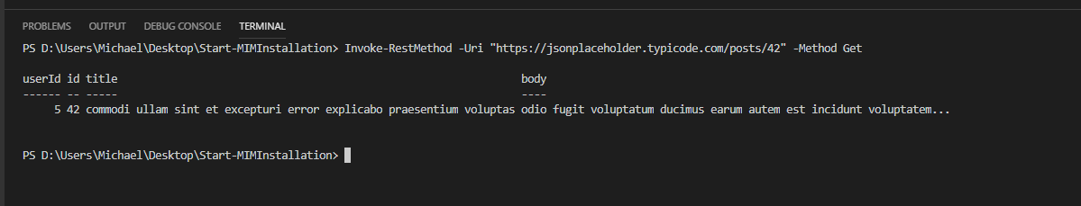
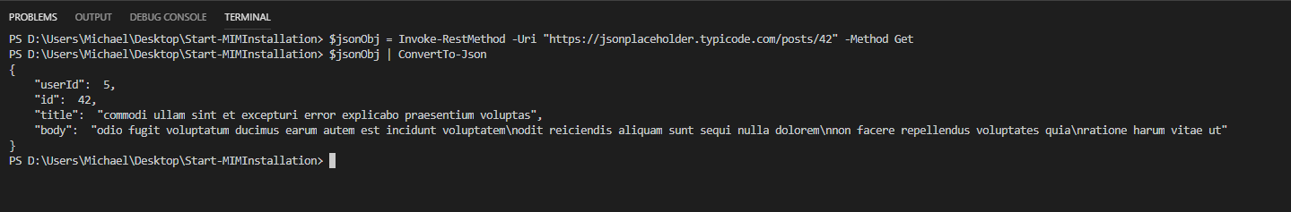
What is JSON?
Notes:
Java Script Object Notation is a open source standard file formant that uses clear readable text to transmit data between two different objects.
PowerShell us able to convert to and from Json using ConvertTo-Json and ConvertFrom-Json

Slide 14

HTTP Breakdown
• URI
• Header
• Body
• Request Method
Status Codes
Notes:
URI: Uniform Resource Identifier is a Identifier
The HTTP Header are key value pairs that describes the parameters of the HTTP request. In this instance we will be focus on the following header field names:
Accept-Encoding (Instructs the Server on what Encoding type that has been transmitted). This can be Json, XML, UTF 8, ACSII:
Authorization: (Refers to the authentication component to the header. Oauth and Oauth 2.0 utilize the authorization header to validate user authentication. Oauth 2.0 utilize JWT’s while Oauth use Client Secret tokens.
The body is the data bytes that are transmitted to the destination that contains that data.
The request method details what type of request is to be performed. Common ones are:
GET - Read
PUT- Update / Replace
POST - Create
DELETE - Delete
PATCH – Partial Update/ Modify
Status Codes describe the server response:
Error 200s -> OK
Error 300s -> Redirect
Error 400s -> Client Error
Error 404 -> Resource could not be found. (Don’t mistake it for the server not working)
Error 403 -> Forbidden.
Error 407 –> Proxy Authentication
Error 401 -> Forbidden Requires Authentication.

Slide 15

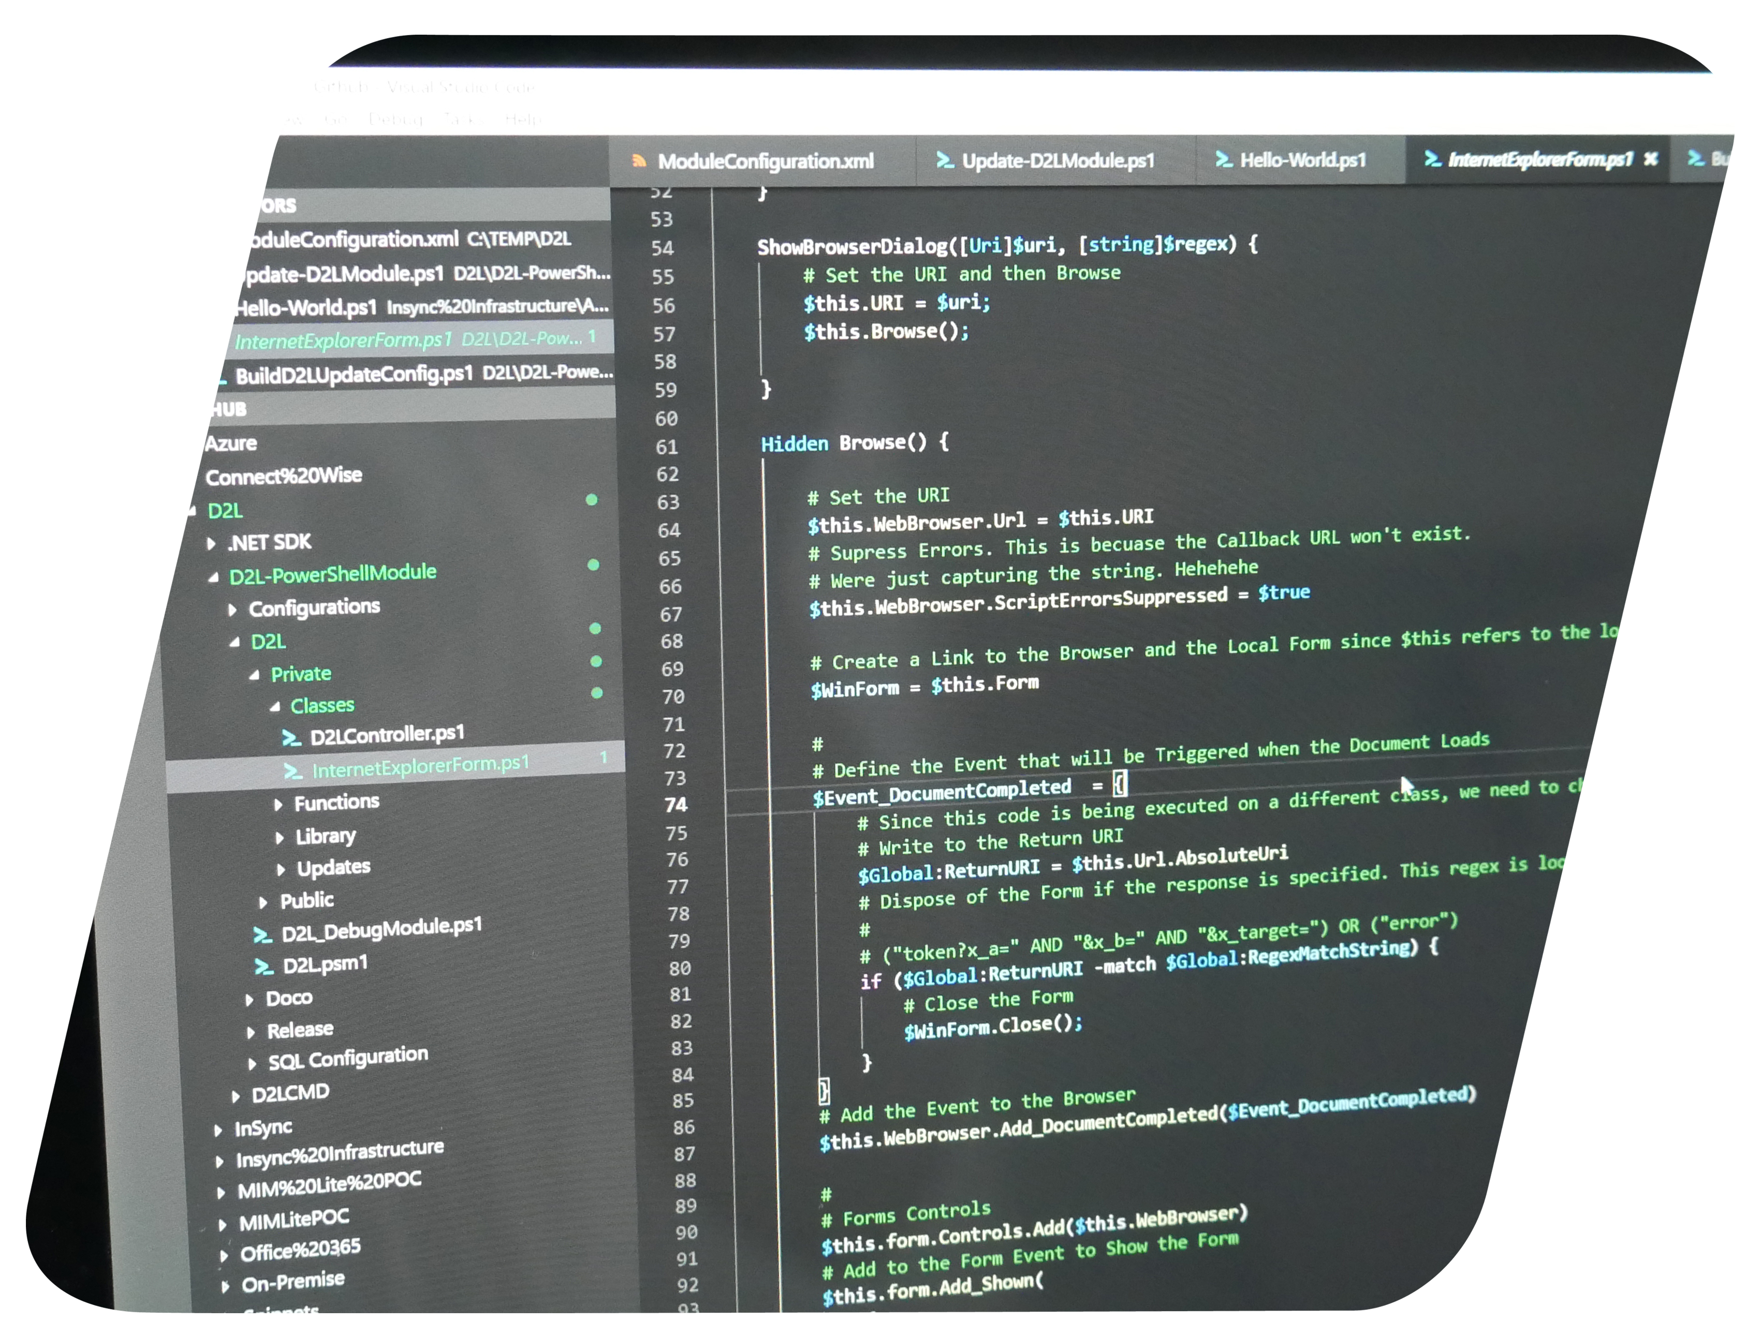
Using REST in PowerShell
• Invoke-RESTMethod
• ConvertTo-JSON
• ConvertFrom-Json
• [XML]

Slide 16



Demo Time!

Slide 17
Real Use Cases

Slide 18
Questions?

Slide 19
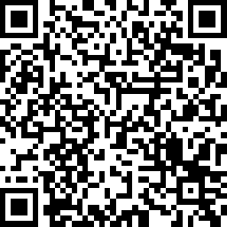
Feedback?

